Slide 1
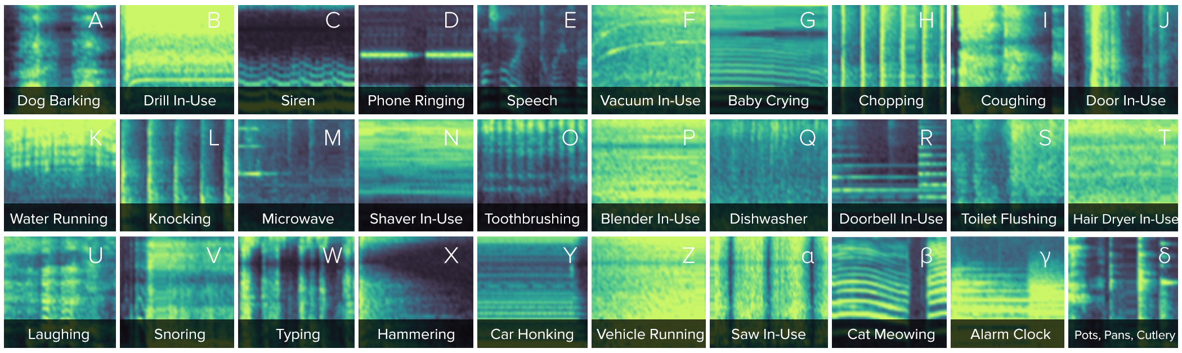
Acoustic Activity Recognition
Project Guide-
Prof. Yuvraj Agarwal, Carnegie Mellon University
Asst. Prof. R. Srinivasan, SRM IST
Submitted by-
Ashwin K Ashok
RA1511003010616

Slide 2

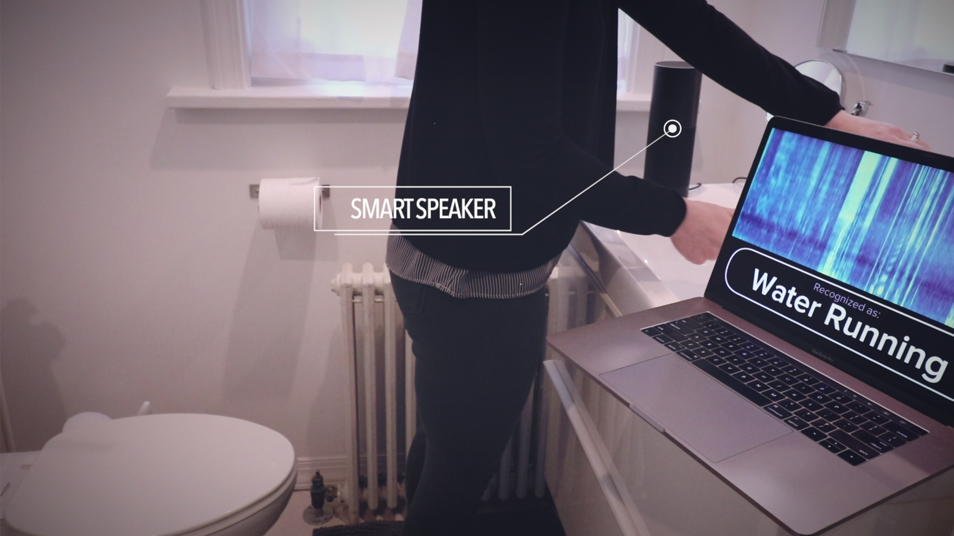

INTRODUCTION
The project aims to develop a systematic approach for training and developing a system that can recognize and understand the sounds in the surrounding environment and hence provide sound based IOT solutions.

Slide 3
LITERATURE SURVEY
EVENT CLASSIFICATON
AudioSet by google
SoundNet
DeepEar
REAL-TIME ACTIVITY RECOGNITION
BodyScope
Mites
Jamie A. Ward

Slide 4

MODULES OF THE SYSTEM
DATA AUGMENTATION
DATA PRE-PROCESSING
CNN MODEL
CLASSIFICAITON OUTPUT

Slide 5
DATASET
Multiple professional sound effect libraries predominantly used in the entertainment industry are combined to obtain a set of clean and accurate sound data.
Reasons for using sound effect library:
Very less noise
Easily transformed into hundreds of realistic variations (Data augmentation).

Slide 6
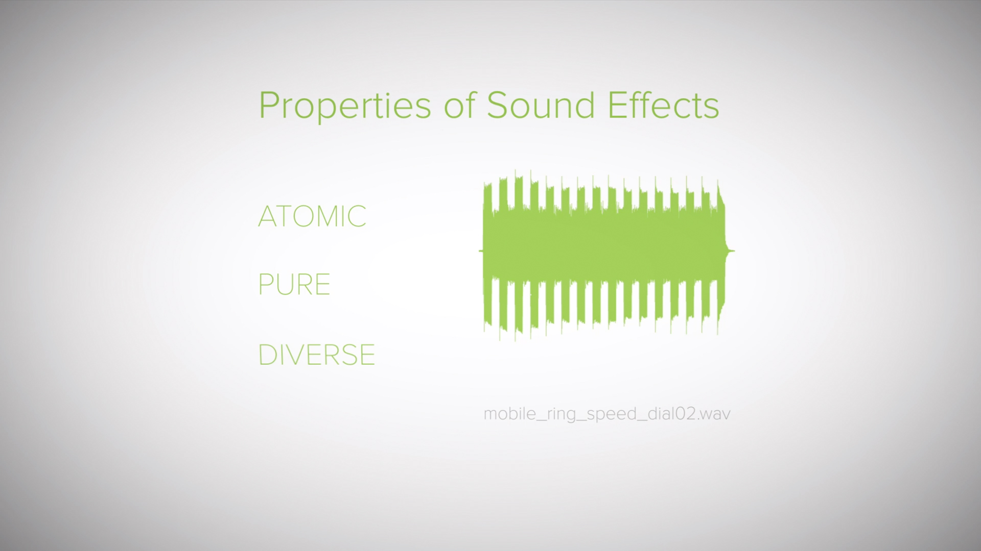

Slide 7
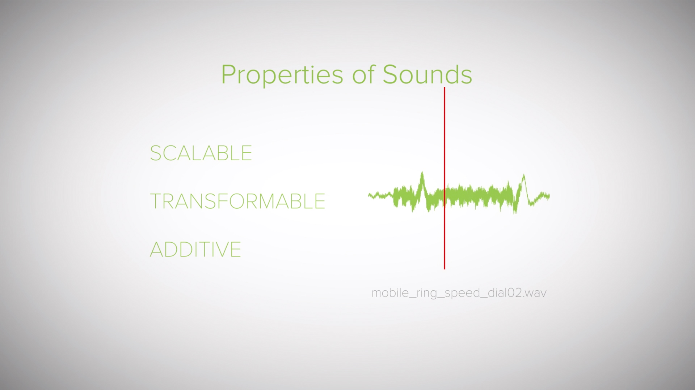

Slide 8
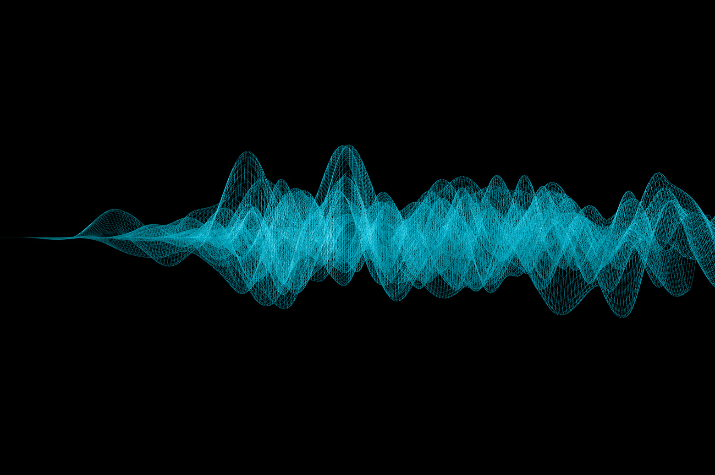
DATA AUGMENTATION
To improve the dataset and provide useful variations of existing sound data, we implement data augmentation using the fundamental principles of sound.

Slide 9
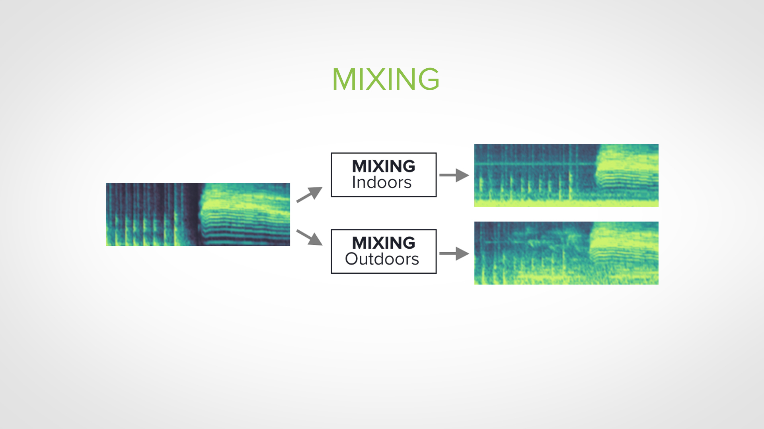

Slide 10
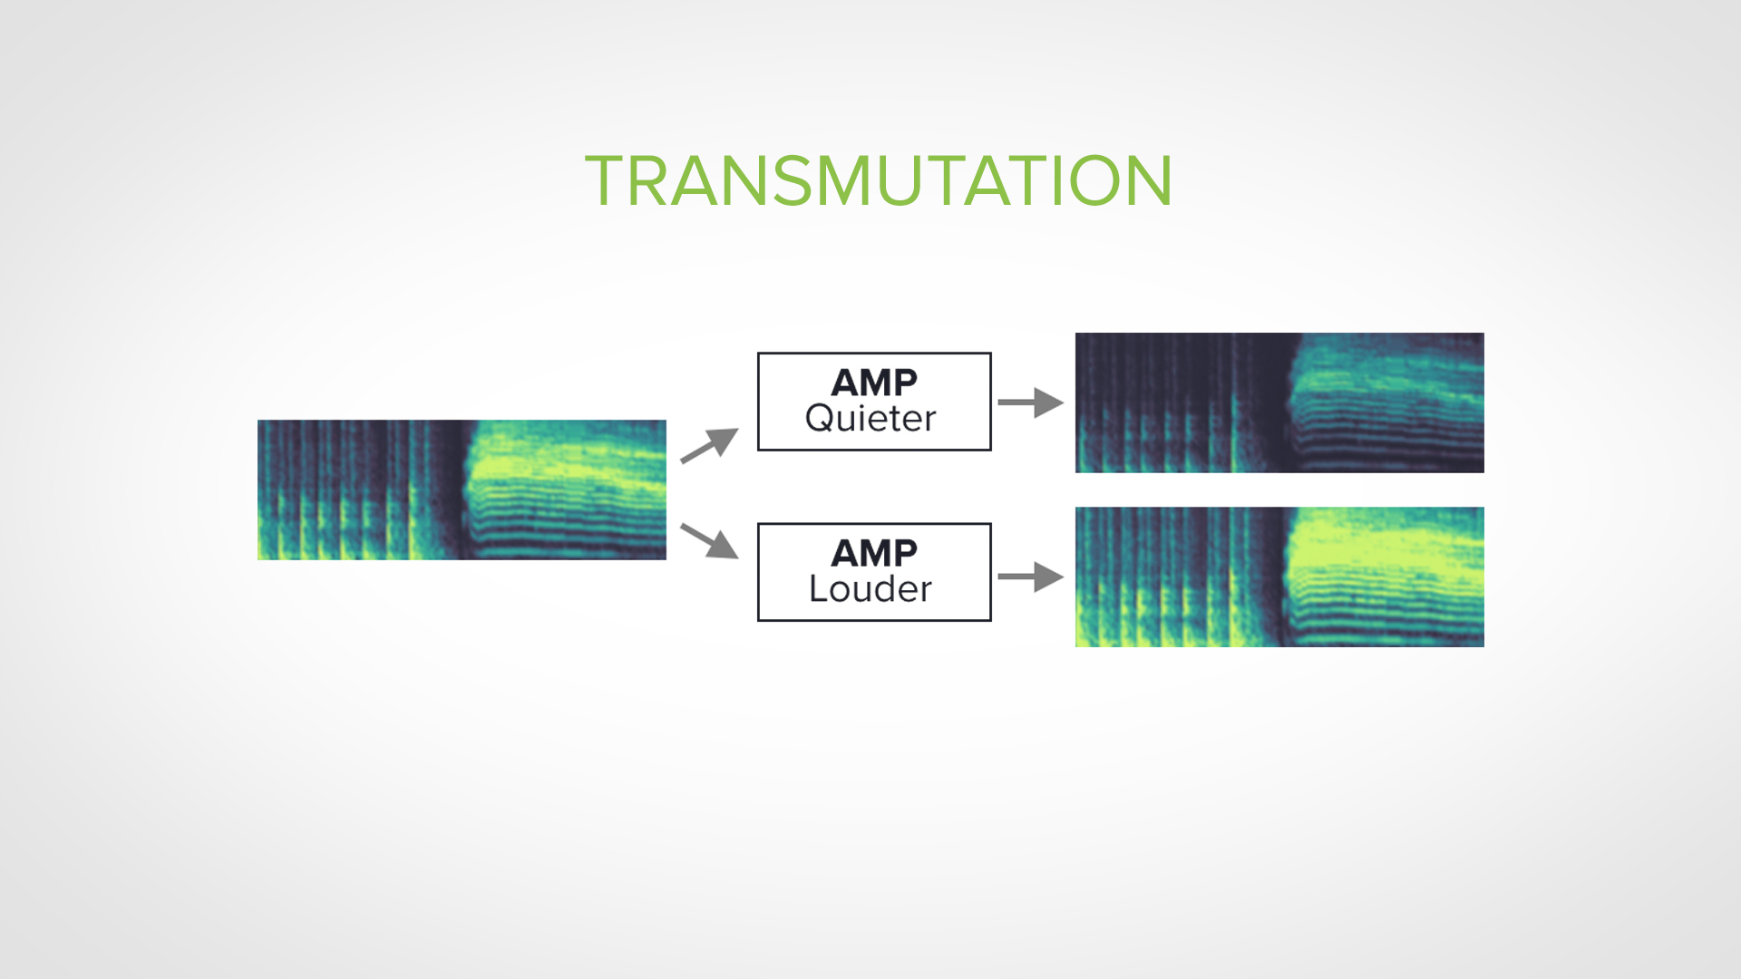

Slide 11
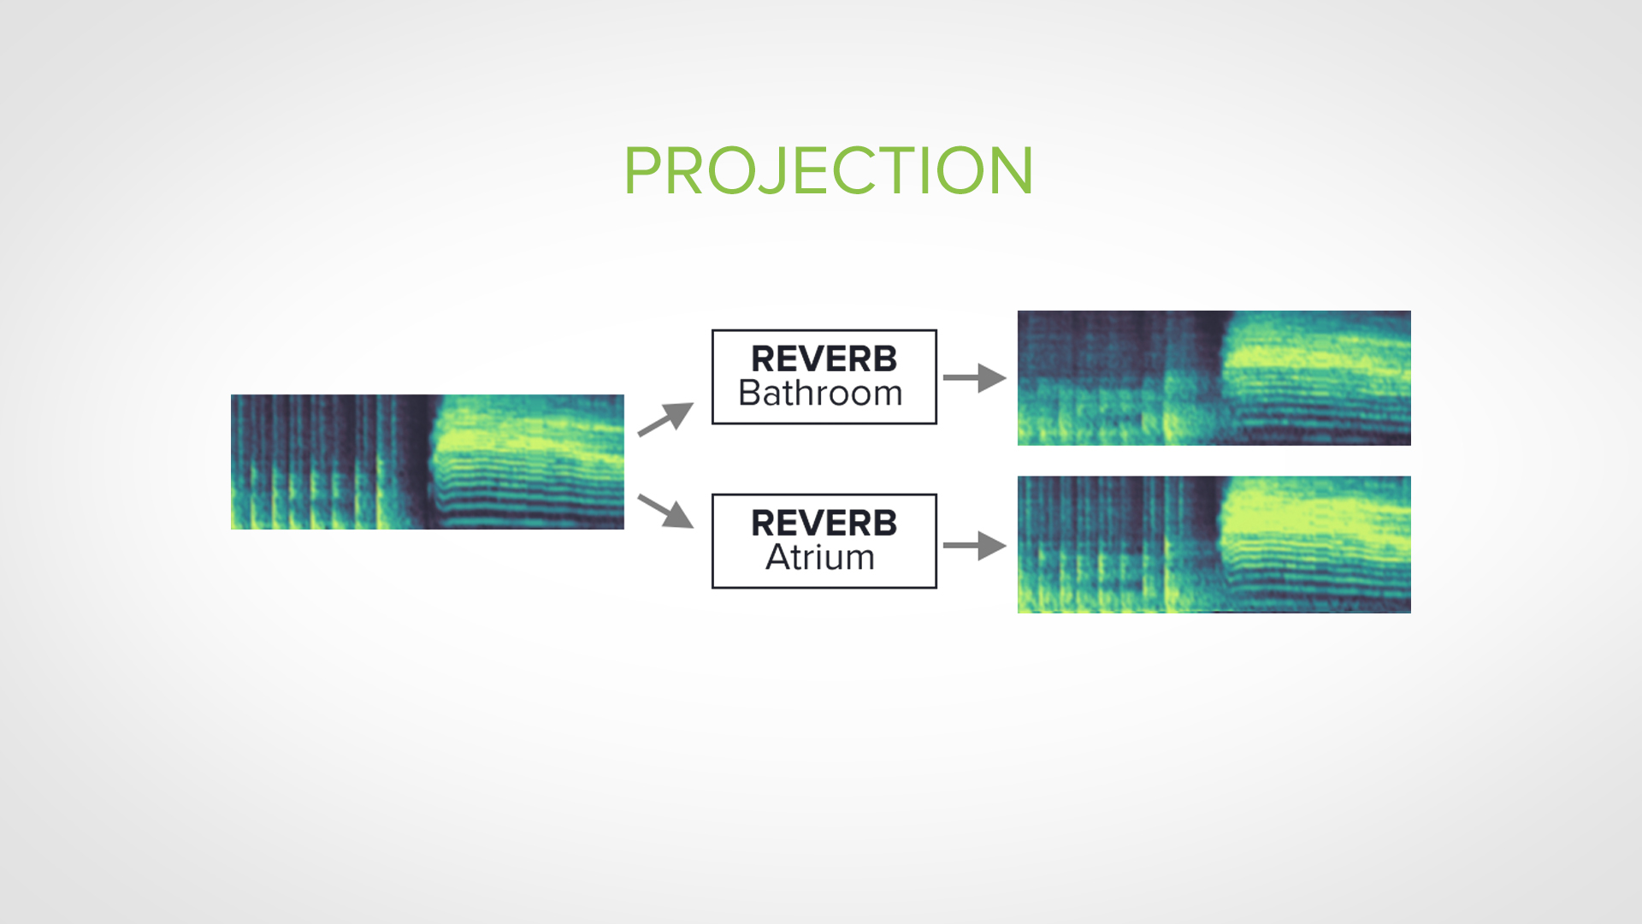

Slide 12
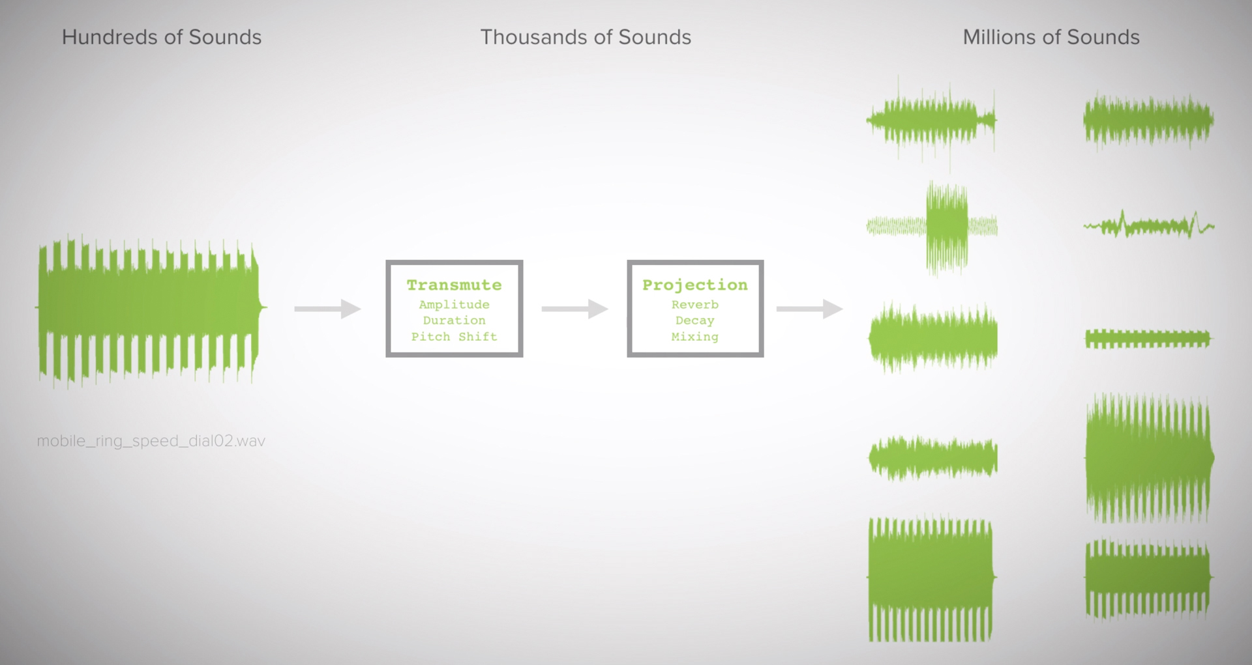

Slide 13
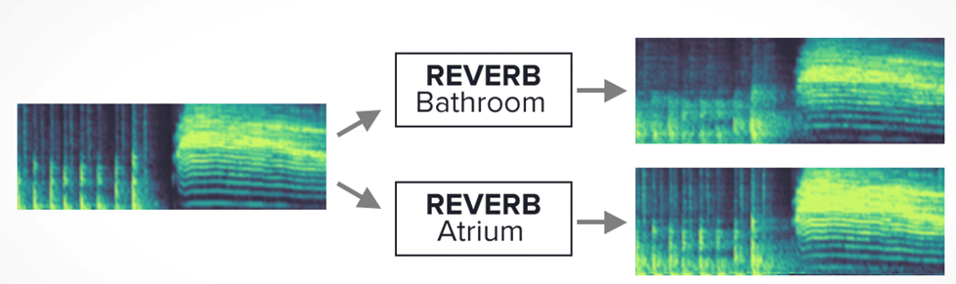
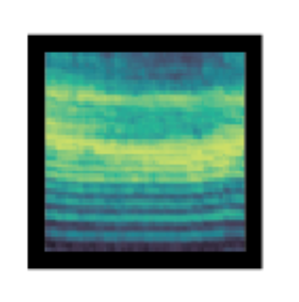
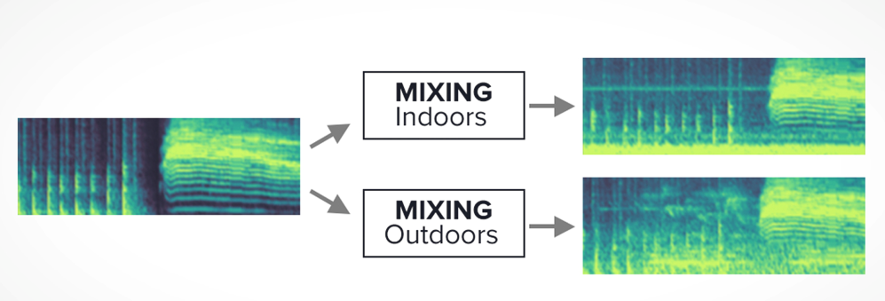
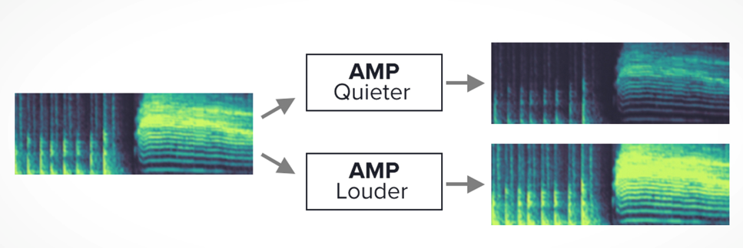
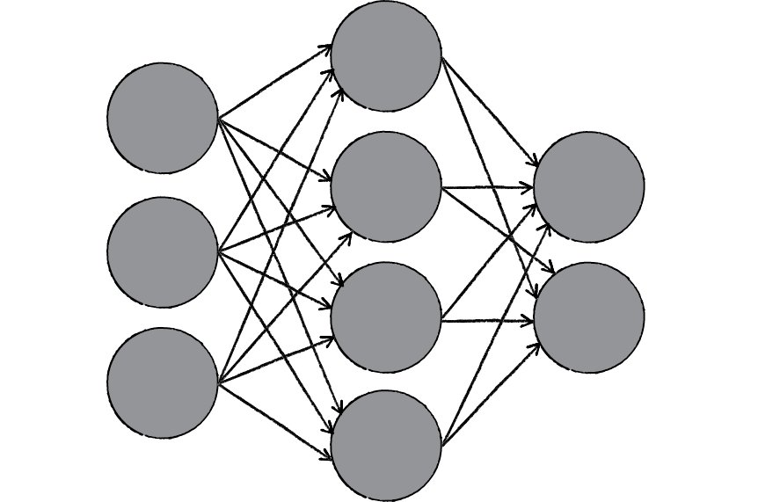
SOUND RECOGNITION SYSTEM
DATA AUGMENTATION
DATA PRE-PROCESSING
CLASSIFICAITON OUTPUT
CNN MODEL

Slide 14
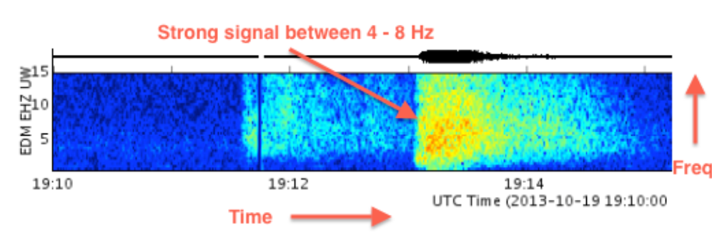
SPECTROGRAM
The Spectrogram View of an audio track provides a visual indication of how the energy in different frequency bands changes over time.
Spectrogram of each class of audio event is unique.
“librosa” python library is used to convert audio to spectrogram.

Slide 15
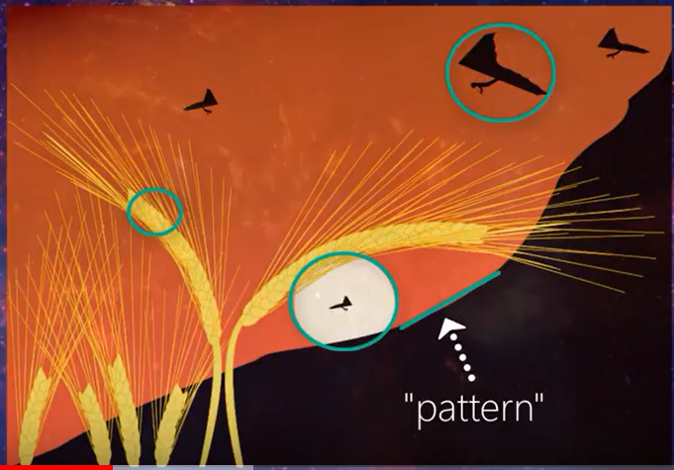
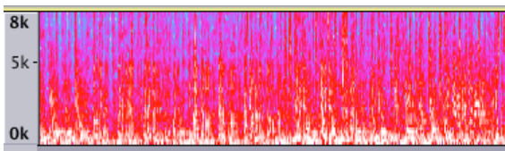
CNN MODEL
VGG is a variant of CNN , it consists of convolutional layer which helps to learn patterns from the image. In each convolutional layer , filters are there to convolve over the image and learn patterns.
As we go deeper into the network filters become more complex and are able to learn more complex features from spectrogram used.

Slide 16
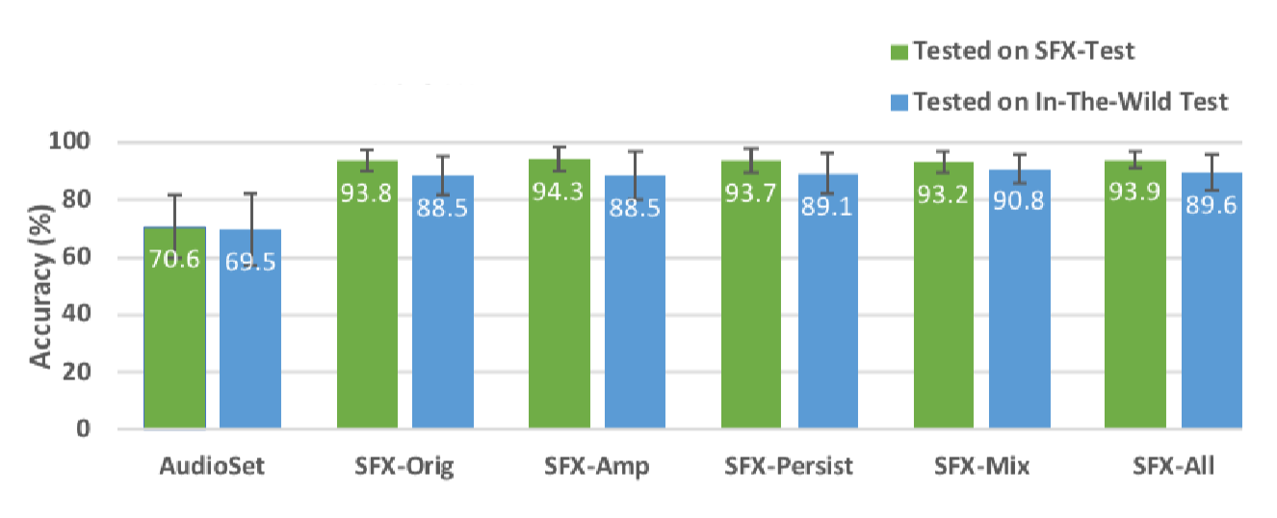
PERFORMNACE

Slide 17
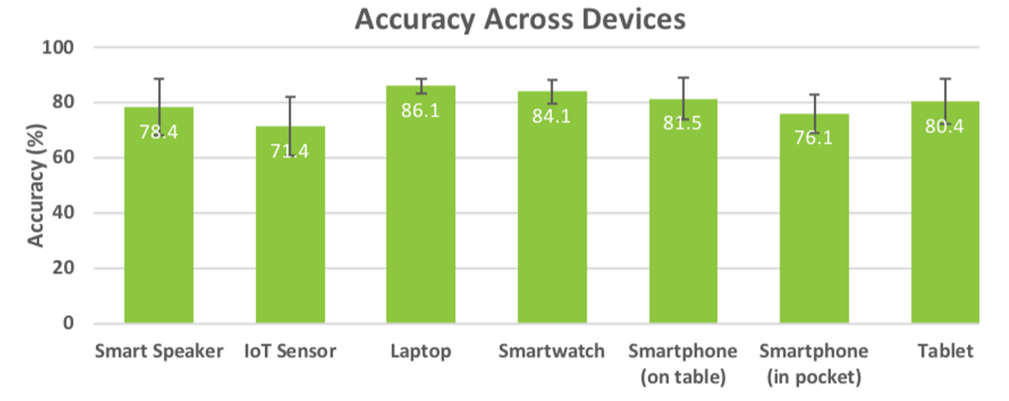
PERFORMANCE ACROSS DEVICES

Slide 18
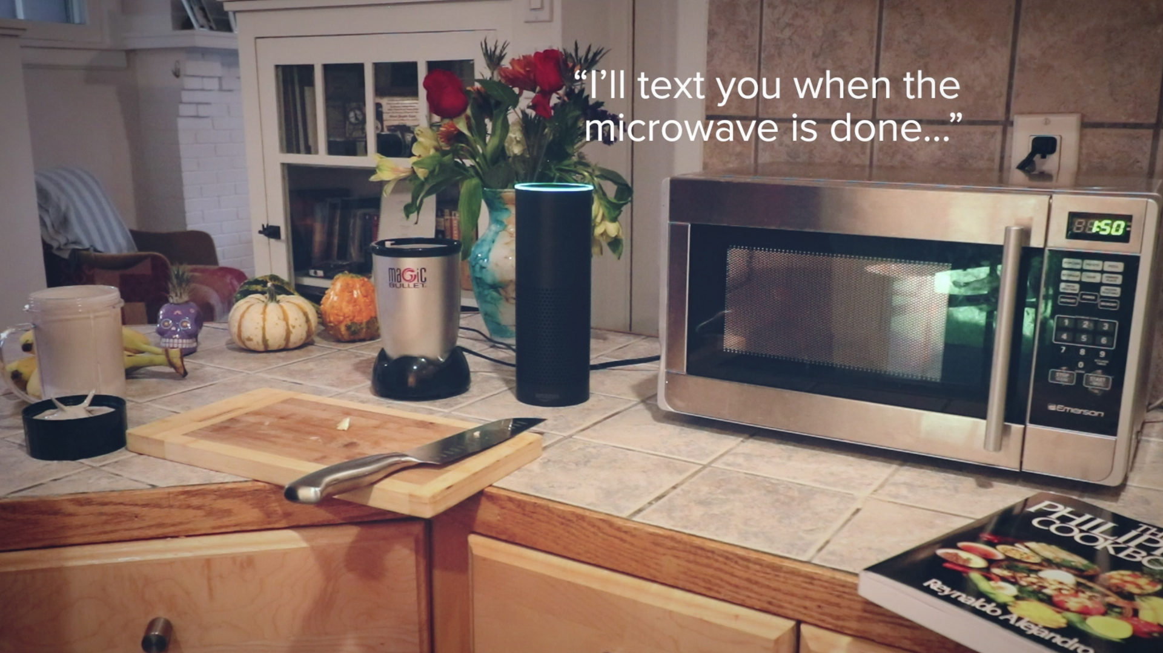
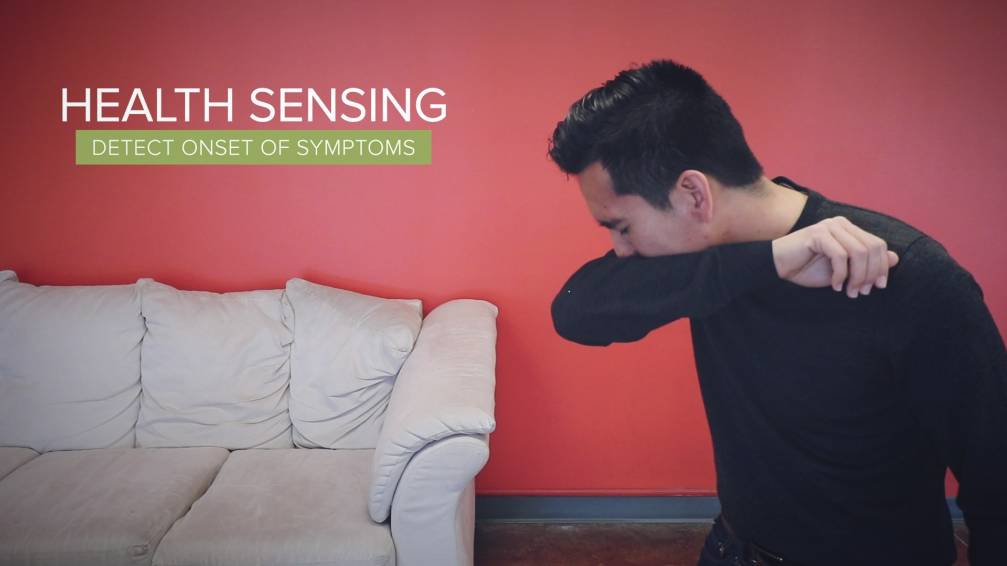
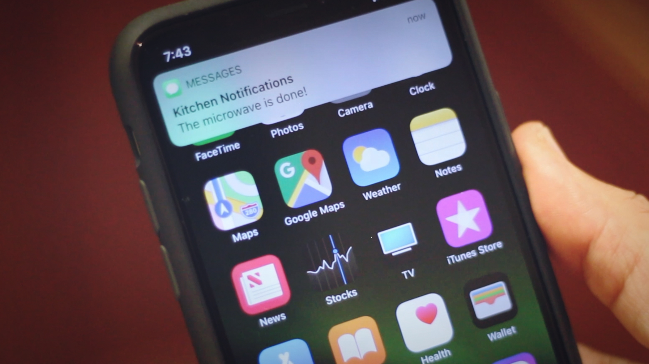
IOT solutions and applications
based on this system

Slide 19
LIMITATIONS
PRIVACY
SIMULTANEOUS EVENTS

Slide 20
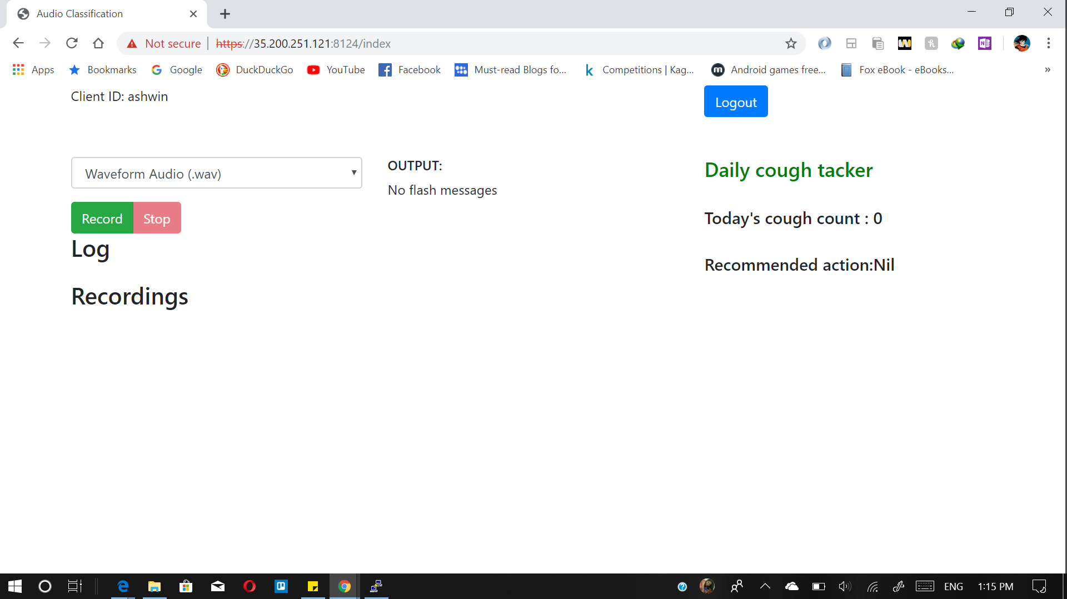
SCREENSHOTS

Slide 21


Slide 22
THANK YOU

